Slide 1
KIOO LIMITED
An ISO 9001:2008 company

Slide 2
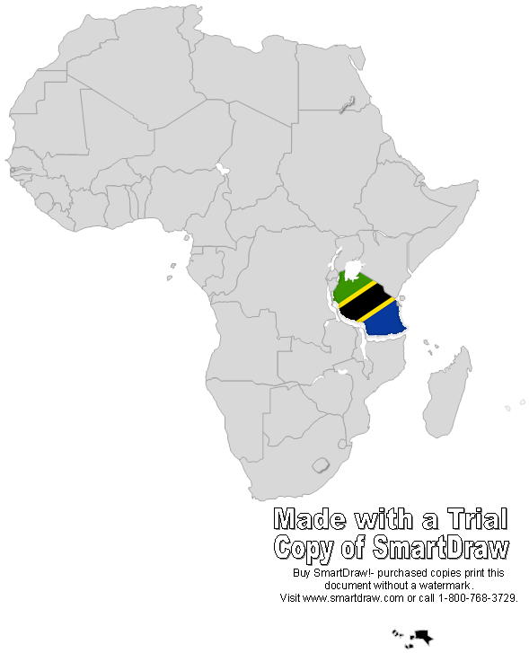
About KIOO
KIOO is Kiswahili for “Glass”
Started Operations in 1963
Largest Manufacturer of Glass packaging
for the Soft Drink, Beer, Liquor,
Food Industries in East and Central Africa

Slide 3
Current Operational Facts
Uninterrupted Operations for last 51 yrs
Installed Capacity – 85,000 tons per annum or 360 million bottles on a 24 x 7 basis
Furnaces in Operation – Two with 5 production lines
Energy Source – Natural Gas for Glass Melting as well as production of electricity for motive power.

Slide 4
Energy
Glass manufacturing is an extremely energy intensive industry, with more than 1/3rd of our cost being energy.
Reliability and steady source of supply of energy is a lifeline.
Until Gas was commercially available in early 2005, we were melting Glass using Fuel Oil and we were completely dependent on TANESCO for our electricity needs.
We currently use almost 1,600 GJ of Natural Gas per day for melting glass and another 1000 GJ for generating electricity

Slide 5
Installed Power Generation Capacity
With unreliable power from the grid affecting our productivity and quality almost on a daily basis, we decided to invest in Gas fired generators to run as our base power in 2010.
It was a big decision in terms of investment and running costs.
We decided to take the plunge and we are today vindicated in our decision.
The installed capacity of our power house is 5.3 MW of which we have almost 70% utilization on a 24 hour basis with 2 generators of 3.3MW and 2.0MW each.
The uptime of these generators are almost 95%.
While cost of operation is slightly higher than the cost of Tanesco’s power, the increased productivity and conseqent improvement in quality weigh’s itself off.

Slide 6
GE – Power House

Slide 7
Decision on GE
With almost no experience in power generation using Natural Gas, the decision on the right choice of generators was a tough one.
We saw met and compared several suppliers, but zeroed in on GE Jenbacher after doing a lot of detailed analysis especially from our industry friends in India and Netherlands.
We believe we took the right decision and must say that we are a satisfied customer in terms of the capability of the generators.

Slide 8
Clarke Energy
When we brought the generators, GE had no service station in the country and the nearest point of service was SA.
This did cause some anxiety and concern as the power house was our lifeline and long stoppage was not an option.
In 2012, Clarke Energy came in as GE Jenbacher’s Sales and Service Agent.
Their coming has made a remarkable difference in the service reliability and must appreciate the prompt and positive minded presence of Mr. Gary Tong, their country representative.

Slide 9
Some Positives
The effect of uninterrupted power supply to our business has been immense.
Production efficiencies that hovered around the mid 80% is now hovering around +90%. This gives us enormous economies and reach.
We are now venturing into farther markets, theoretically exporting Tanzanian Gas to places as far as Ethiopia, DRC, Zimbabwe and Mauritius to name a few.
Quality of our products have drastically improved given that there are no interruptions in the production process, thereby giving our customers tremendous confidence.

Slide 10
Glass Recycles

